Slide 1
Power House Phitness
Beesanne Kurzum, Charlie Olinsky, Christina Rodriguez, Erica Dubie, Olamide Kumapayi
Notes:
Charlie

Slide 2
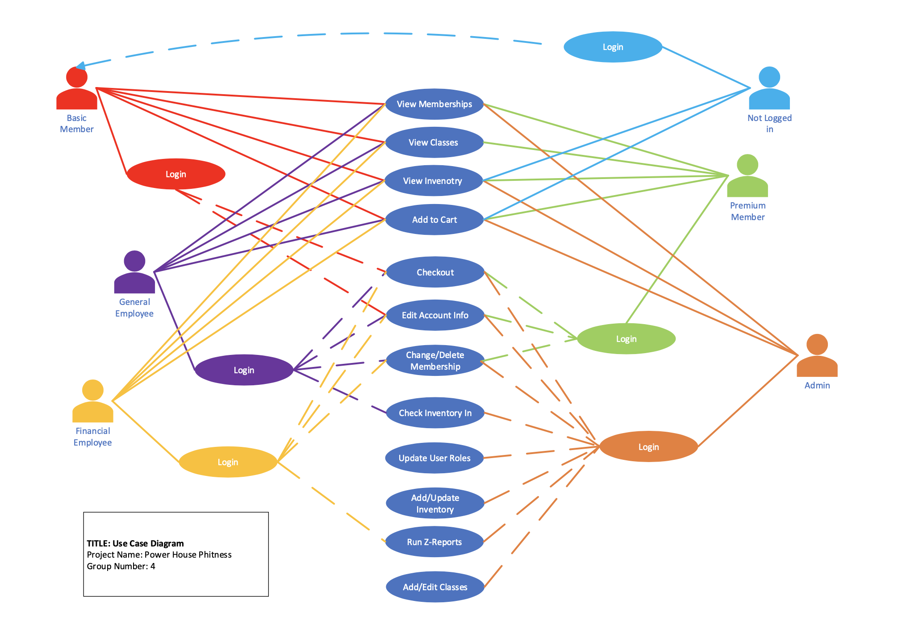
Use Case Diagram
Notes:
Erica

Slide 3
Erica Dubie
User Interface & Services

Slide 4
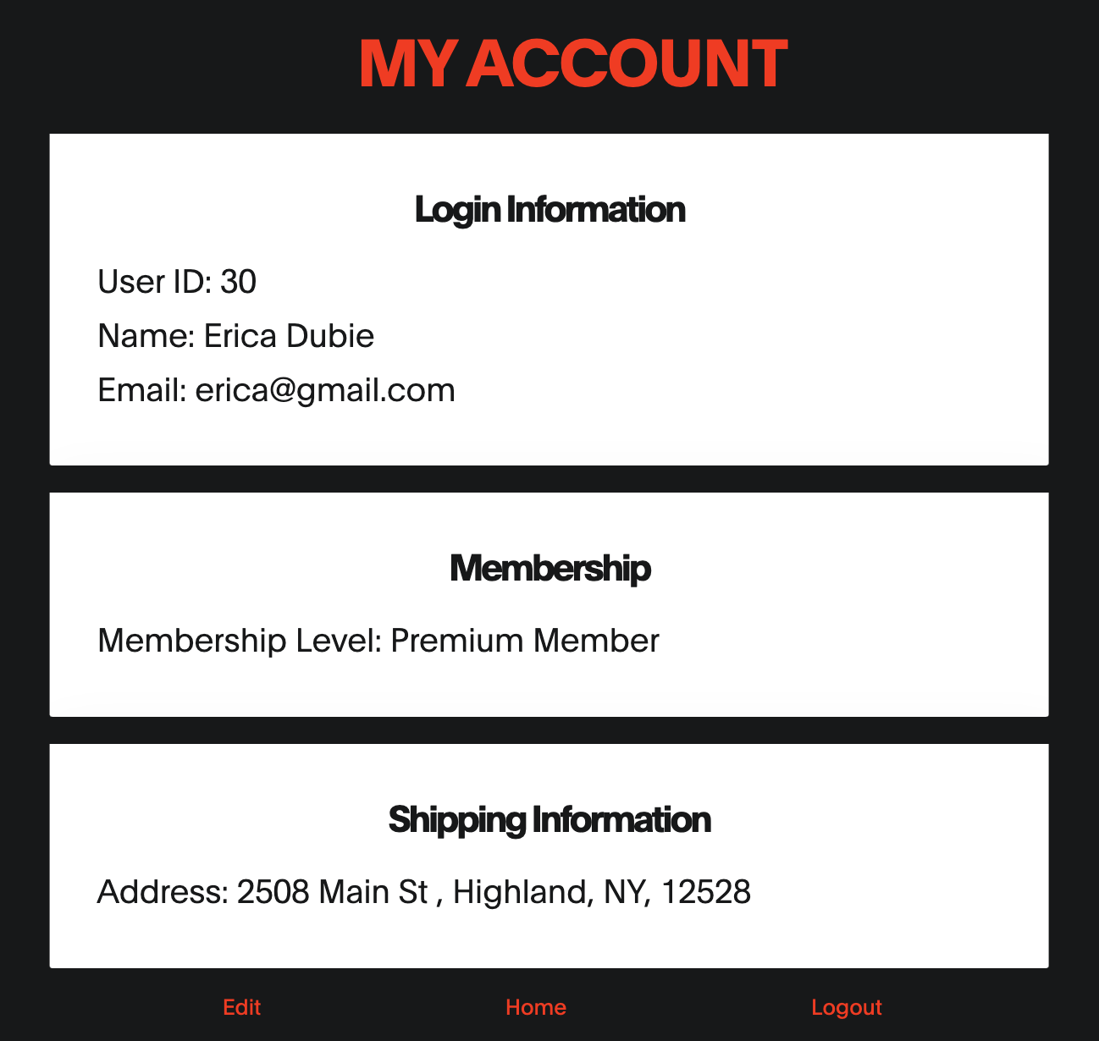
User Interface Theme & Aspects
Intuitive User Experience
User can easily use and understand the website
Consistent
Colors: Red, Black, White
Centered
Square
Different kinds of users: Members, General Employees, & Administration

Slide 5
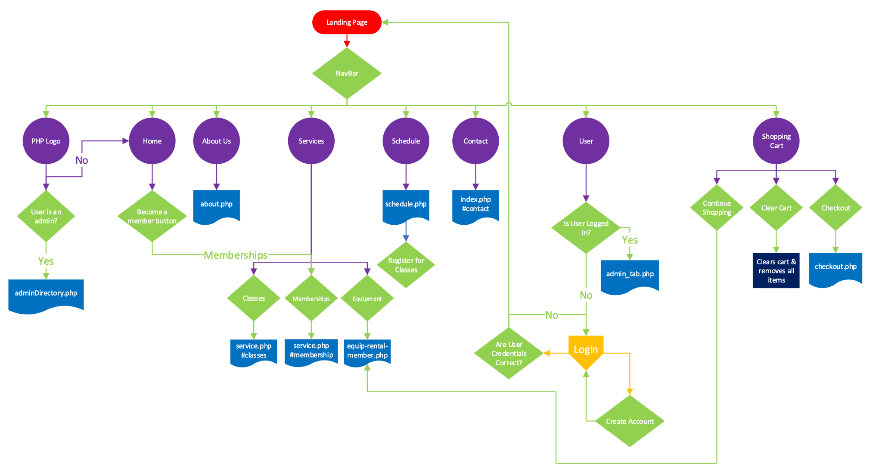
User Interface Flowchart

Slide 6

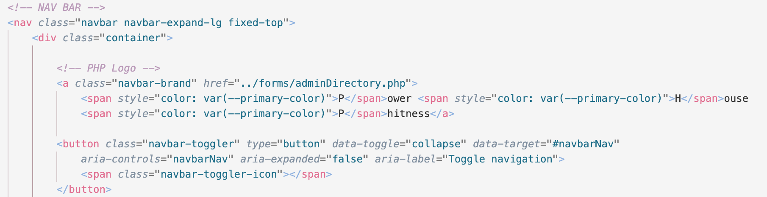
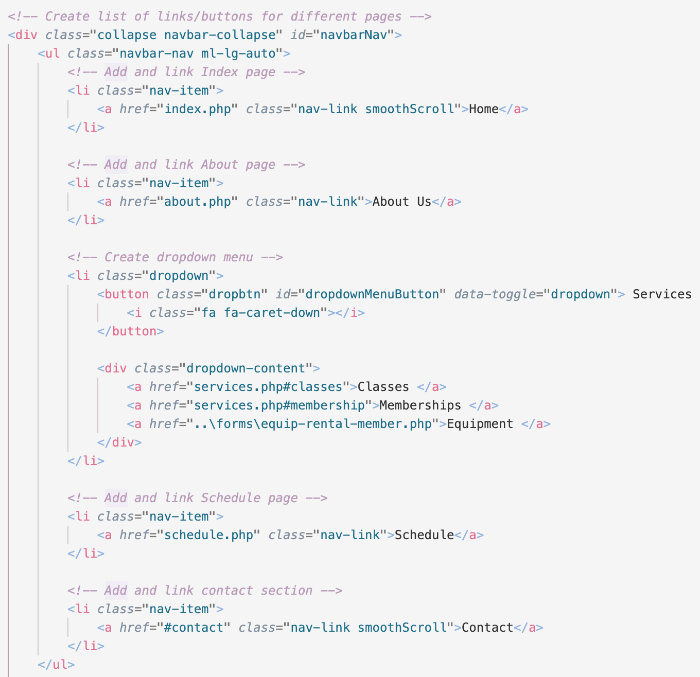
Navigation
Bar
PHP Logo
Toggle Button/Icon
List of NavBar Items

Slide 7
Christina Rodriguez
Users and Financial Reports

Slide 8
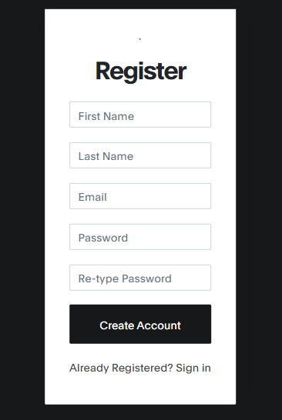
Member Registration:
User
Id: int firstName: string lastName: string Address: string Email: string Password: string membershipLevel: int
_User(): void createUser(): void removeUser(id): void adminRemoveUser(id): void setFirstName(fn, id): void setLastName(ln, id): void setPassword(pass, id): void setMembershipLevel(role, id): void

Slide 9
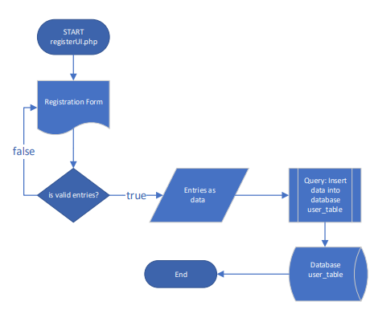
Register Flowchart - registerUI.php

Slide 10
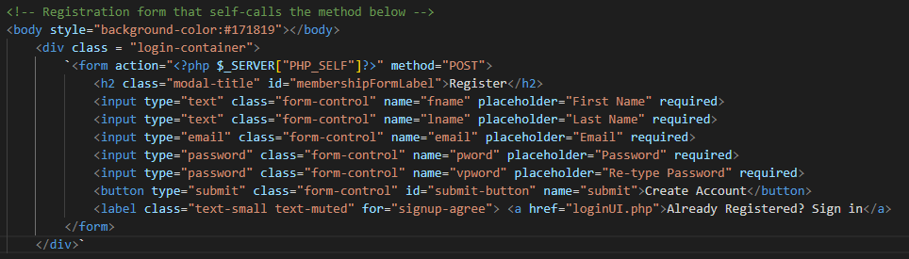
RegisterUI.php - form
Notes:
Labels all input as “required” fields
Labels the “email” field so that it can check for a valid entry (‘@’ symbol)
Password Field so it hides while typing
Requires you to type the password twice to verify that they match
Takes in user input and self-calls to the post-method.

Slide 11
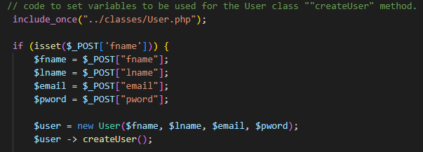
RegisterUI.php - post method
Notes:
Post method stores input into variables.
Creates a user object with variables as parameters.
Uses the object to call the “Create User” method from the user class.

Slide 12
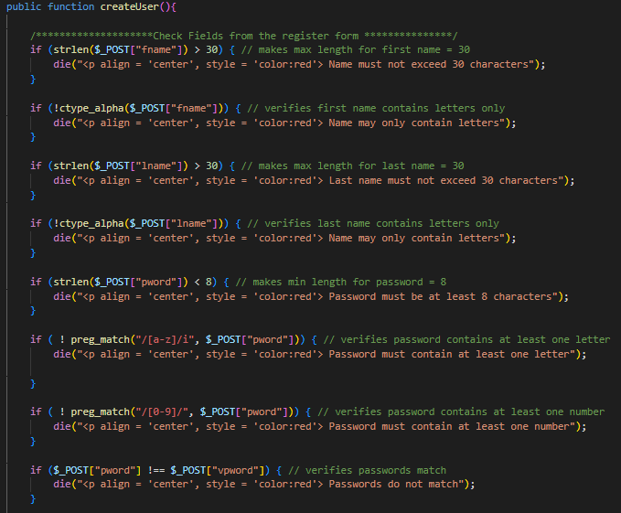
User Class - Create User Method
Data Validation
Notes:
Checks:
Name and last name lengths < 30, and verifies they contain letters only
Password is at least 8 characters, and contains at least one letter and one number
Passwords match

Slide 13
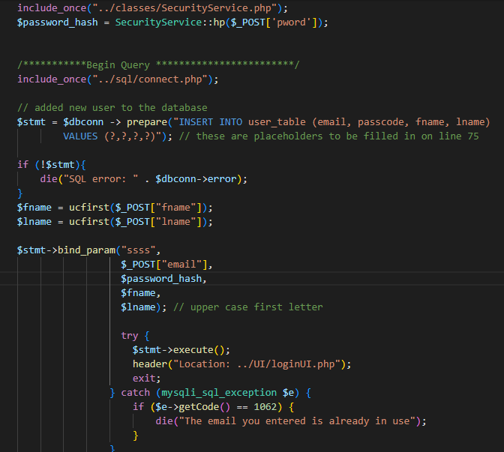
User Class - Create User Method
Notes:
Connects to the database
Auto Capitalizes Names
Error message for if the email is already in use (unique)
Hash the password before inputting into database
Query that inserts the inputted values into the corresponding fields of the user_table in the database
If query is successful, brings you to the login page

Slide 14
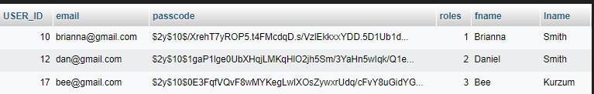
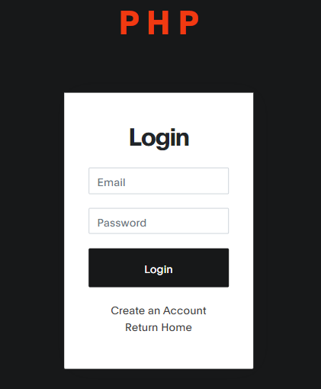
phpMyAdmin - user_table
Login with your email

Slide 15
Beesanne Kurzum
Inventory, Database Management & Shopping Cart

Slide 16
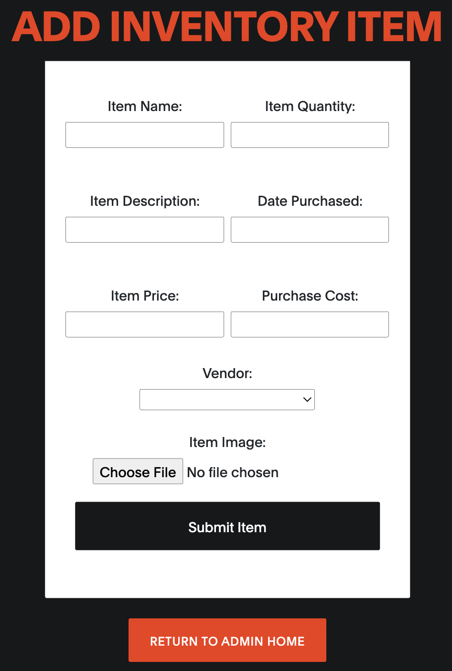
Add New Inventory Feature
Two Main Files:
add-products.php
SQL Queries
admin-inventory-new.php
HTML Form
Data Validation

Slide 17
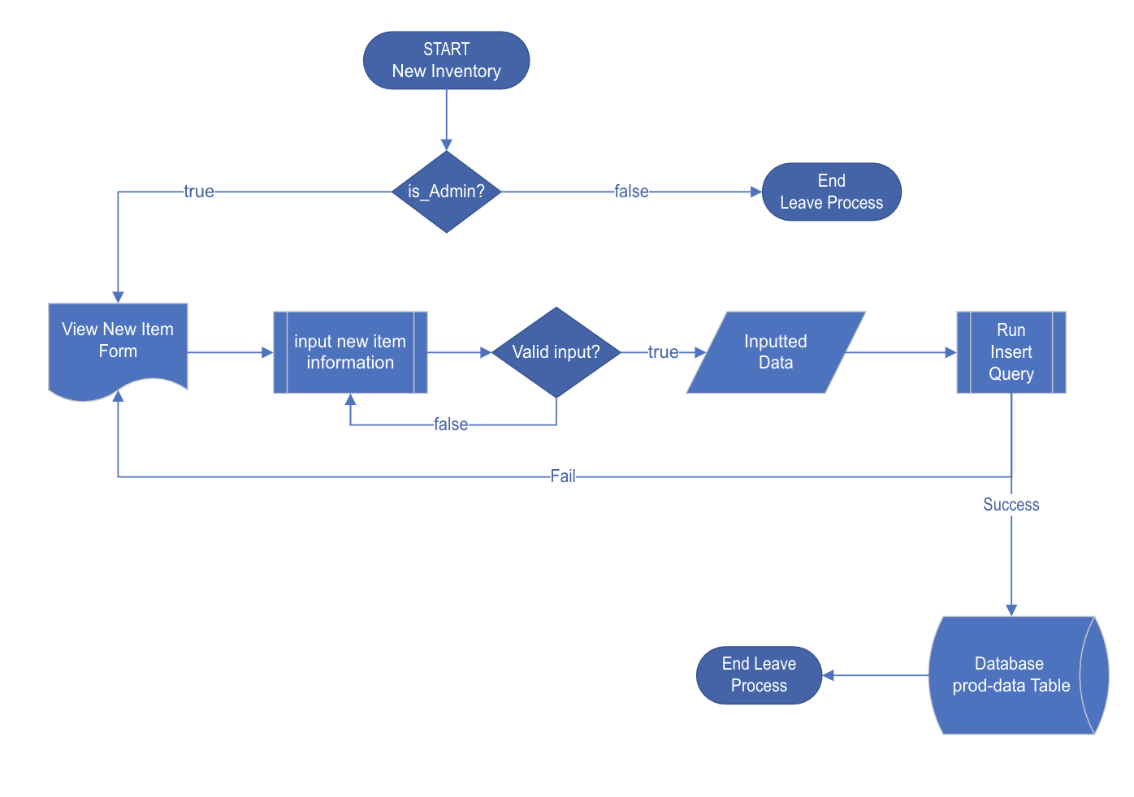
Flowchart

Slide 18

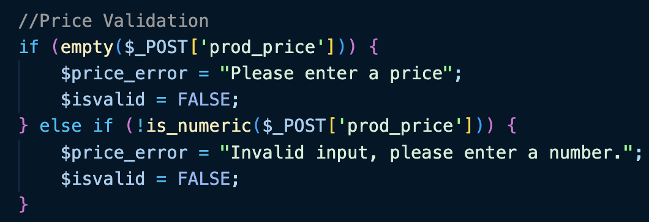
Data Validation
Set $isvalid to true
Set Error Message
If no input was entered
Set $isvalid to false
If the value entered is not a number

Slide 19
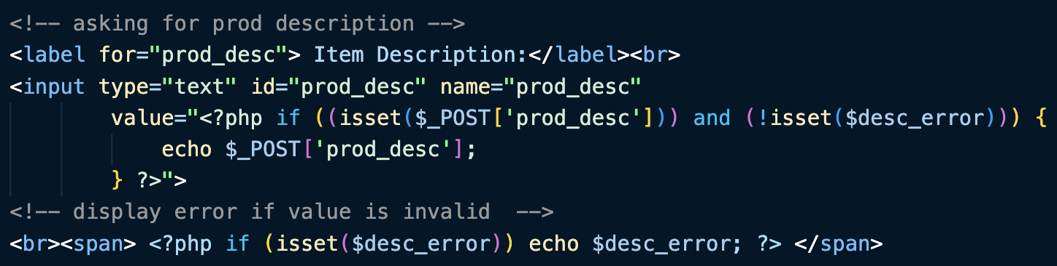
Asking for User Input
Hold the input if valid
If the error variable is set

Slide 20
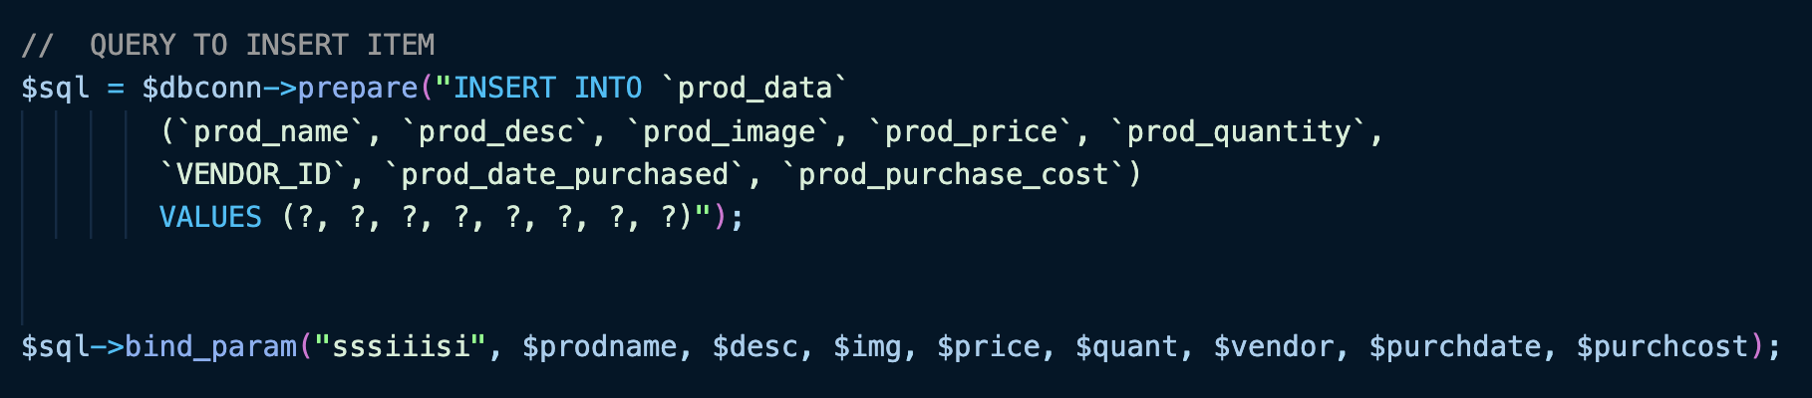
SQL Query
Prepare the INSERT Query
Placeholders for input values
Binding query with variables

Slide 21
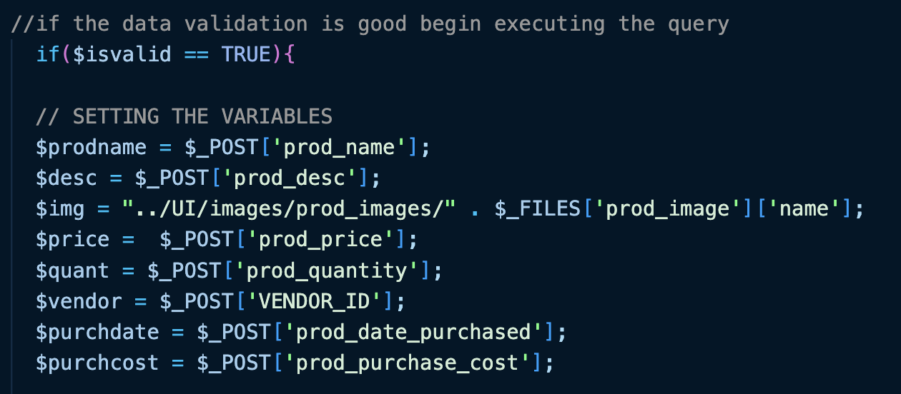
SQL Query - Setting the Variables
If input is valid
Set variables to the user input

Slide 22
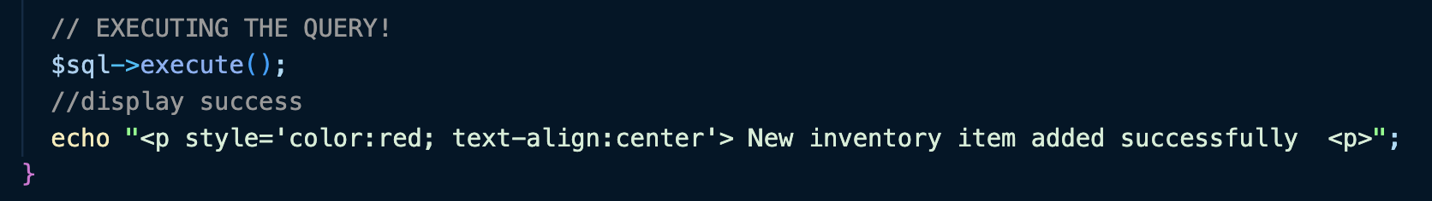
Executing the Query
Execute the Query
Display success!

Slide 23
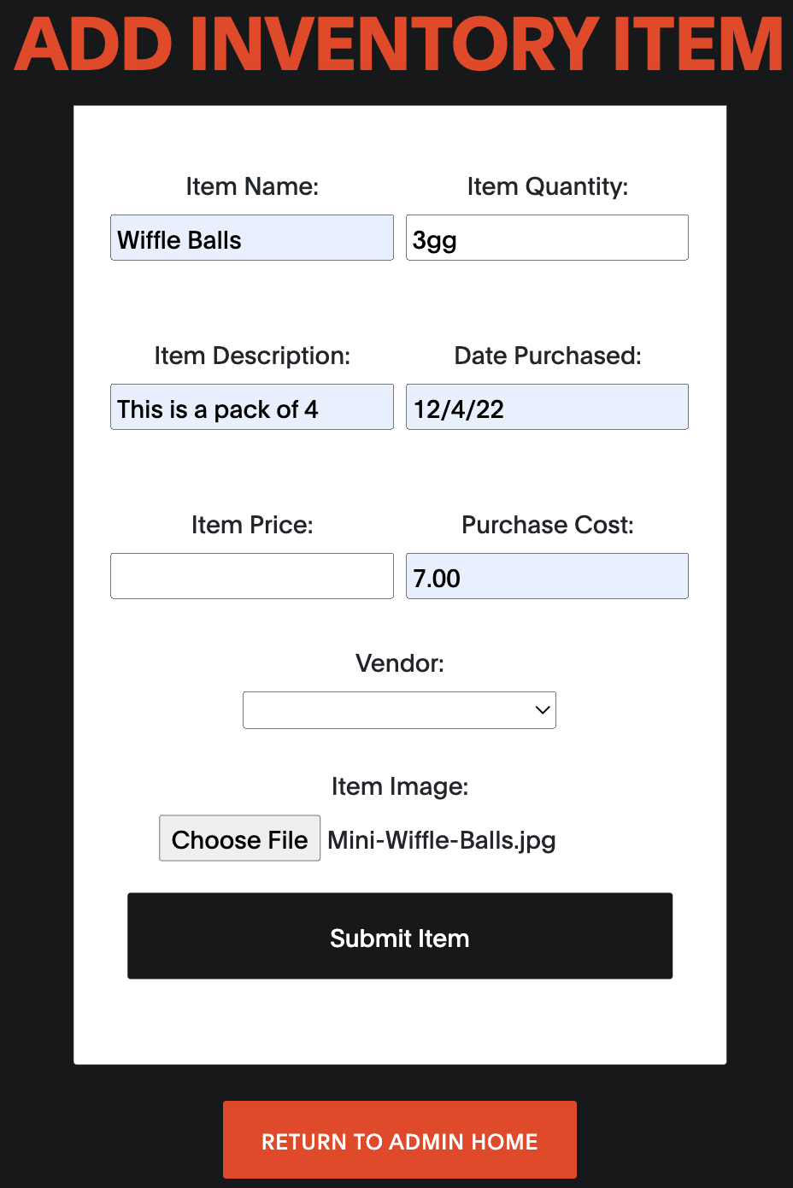
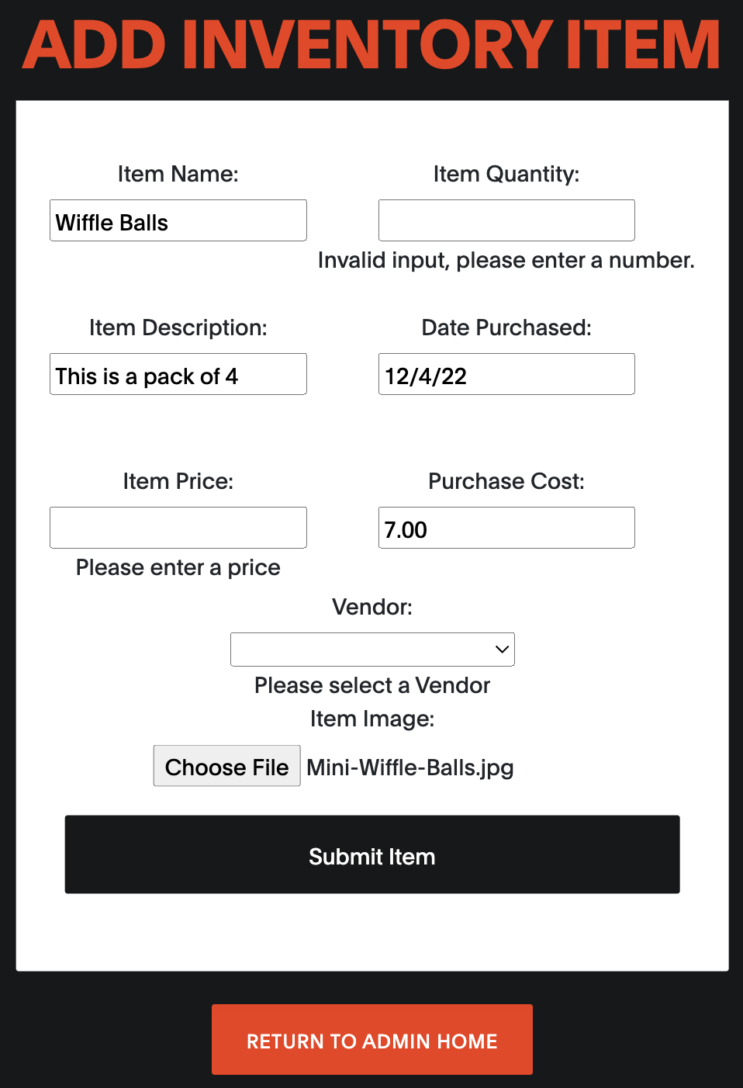
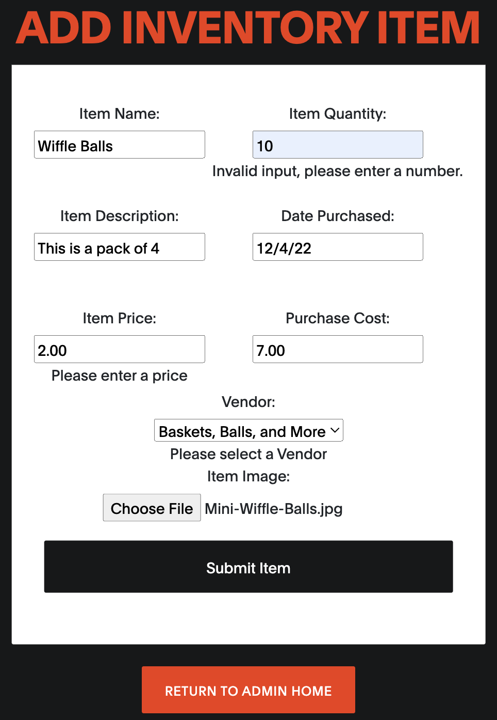
Process Visual

Slide 24
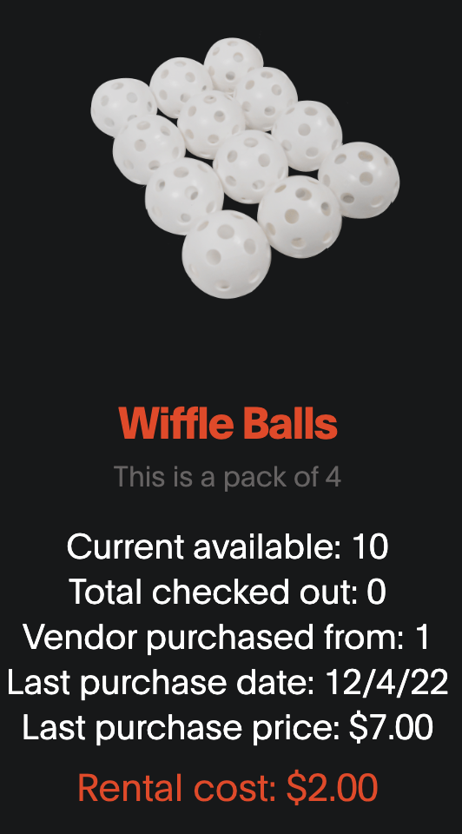
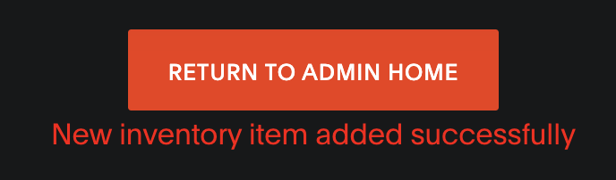
Successful Entry!
Confirm from the admin inventory homepage

Slide 25
Olamide Kumapayi
Shopping Cart and Checkout

Slide 26
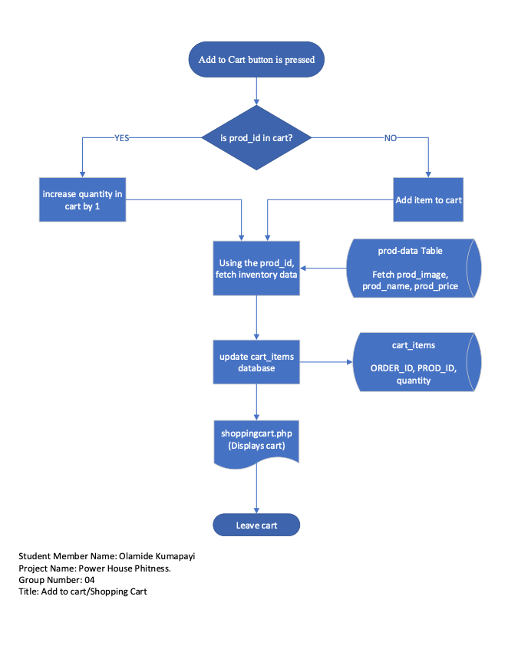
Flowchart

Slide 27
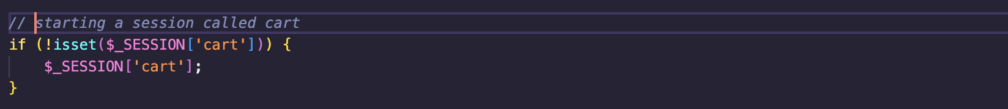
New Cart Session

Slide 28
Emptying the Cart

Slide 29
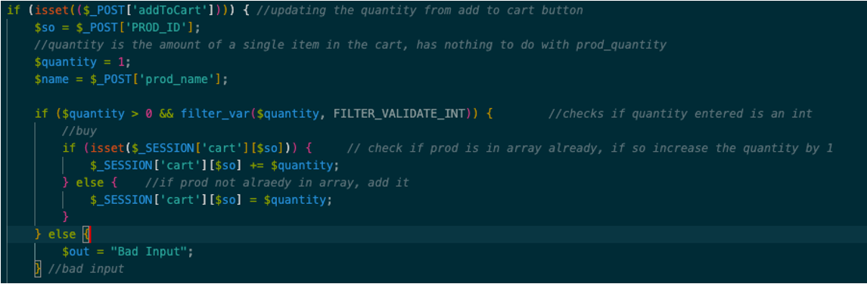
Updating the Quantity

Slide 30
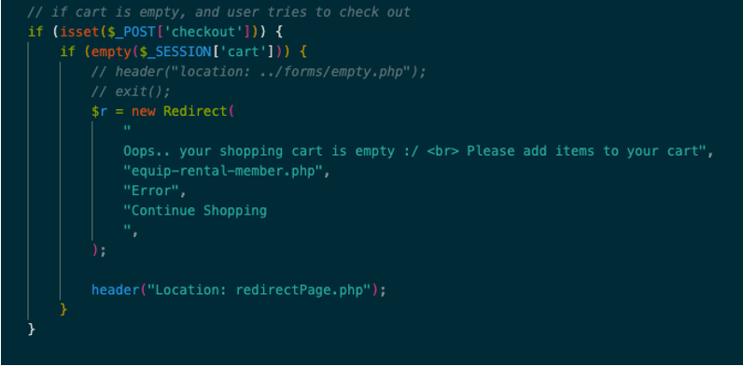
Checking out an empty Cart

Slide 31
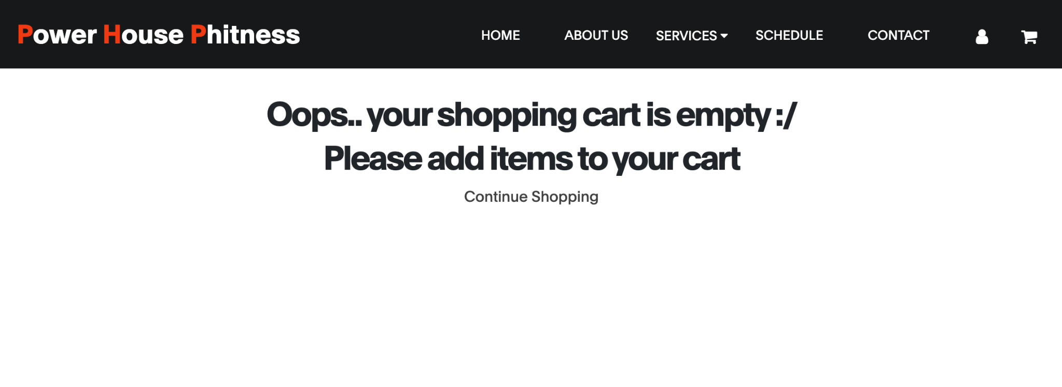

Slide 32
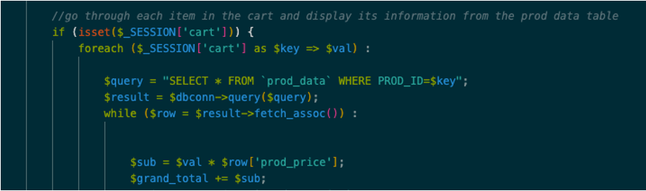
Displaying the items in the cart

Slide 33
Charles Olinsky
Session, Services & Security

Slide 34
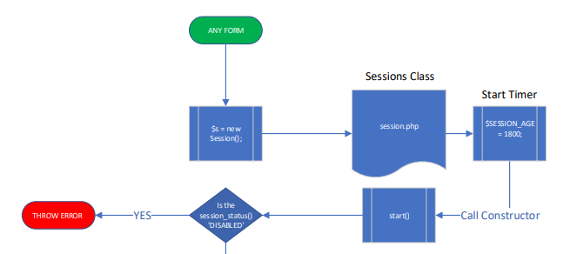
Sessions Class
…

Slide 35
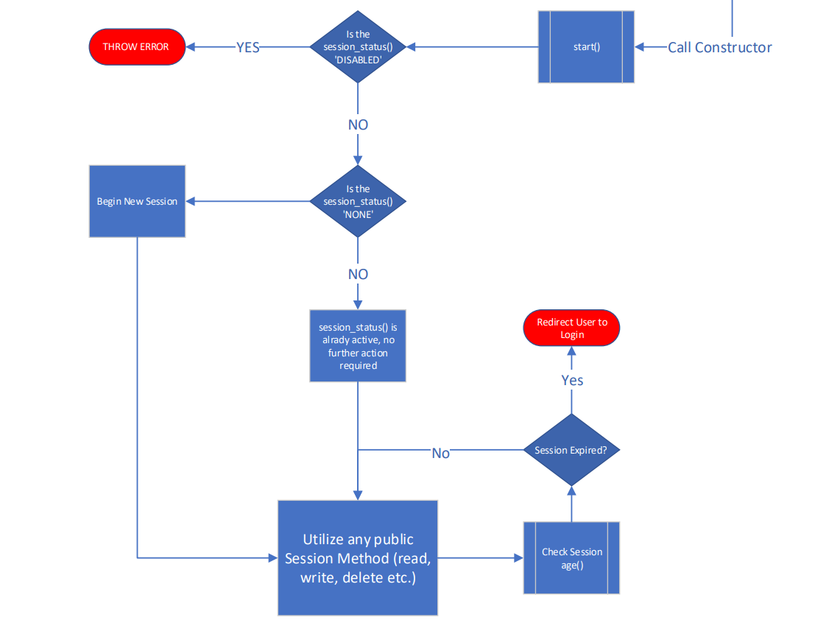
Sessions Class Cont.
…

Slide 36
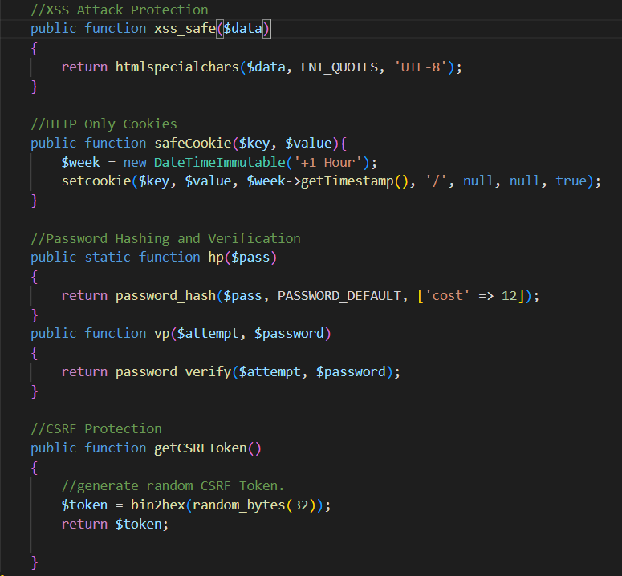
Security Class
Methods Include:
xss_safe($data) -> Filters data to protect against cross site scripting attacks.
safeCookie($key, $value) -> Creates HTTP only cookies to prevent users from using ‘document.cookie’ to view sensitive data in browser console.
hp($pass) -> Hashes a given password using a bcrypt algorithm and random salt.
vp($attempt, $password) -> Verifies that the given hashed password matches the hash of the attempt.
getCSRFToken() -> generates a secure random token used to prevent Cross-Site Request Forgery Attacks

Slide 37
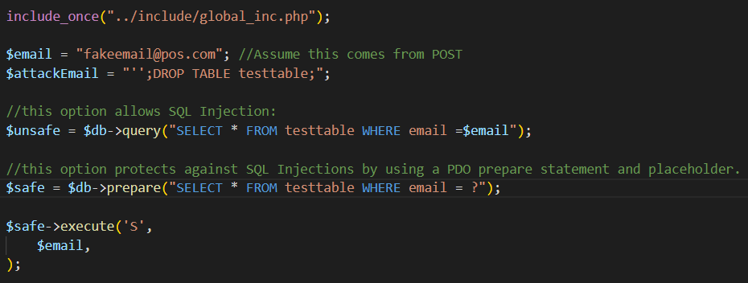
Security Cont: SQL Injections

Slide 38
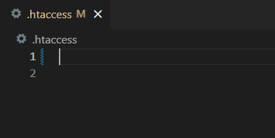
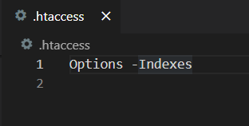
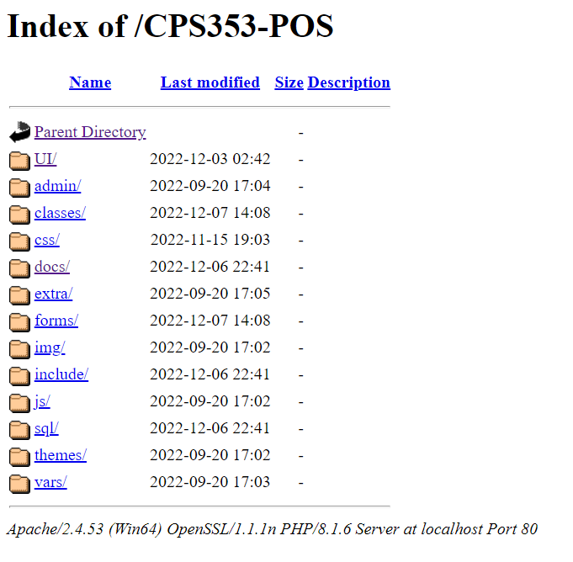
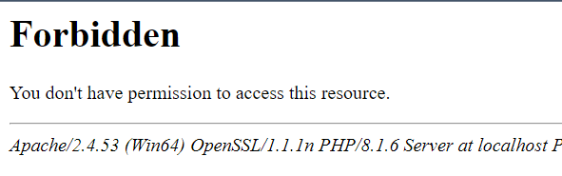
Security Cont: htaccess

